Slide 1



PEILab Group Meeting

Slide 2
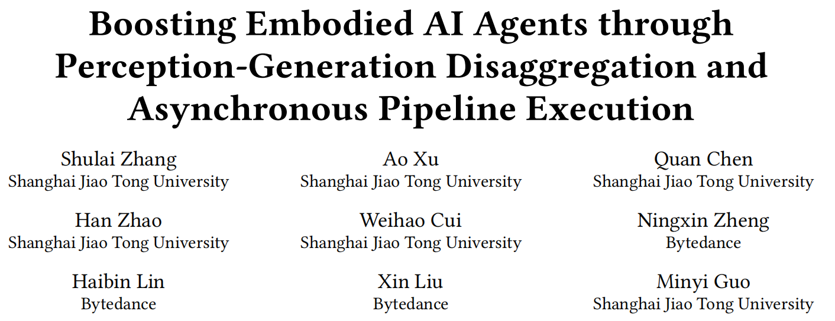
Auras

Slide 3
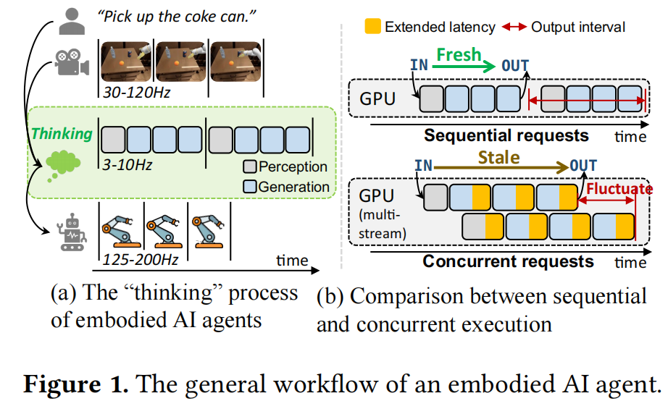
Auras
Motivation
Embodied AI systems operate in dynamic environments, requiring seamless integration of perception and generation modules to process high-frequency input and output demands. Traditional sequential computation patterns, while effective in ensuring accuracy, face significant limitations in achieving the necessary "thinking" frequency for real-world applications

Slide 4
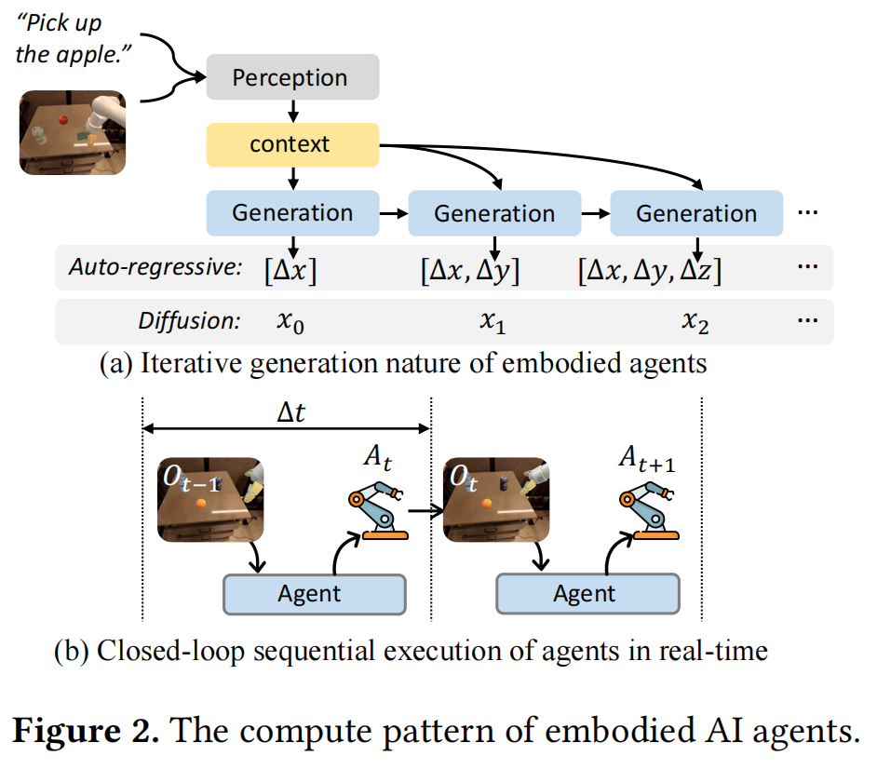
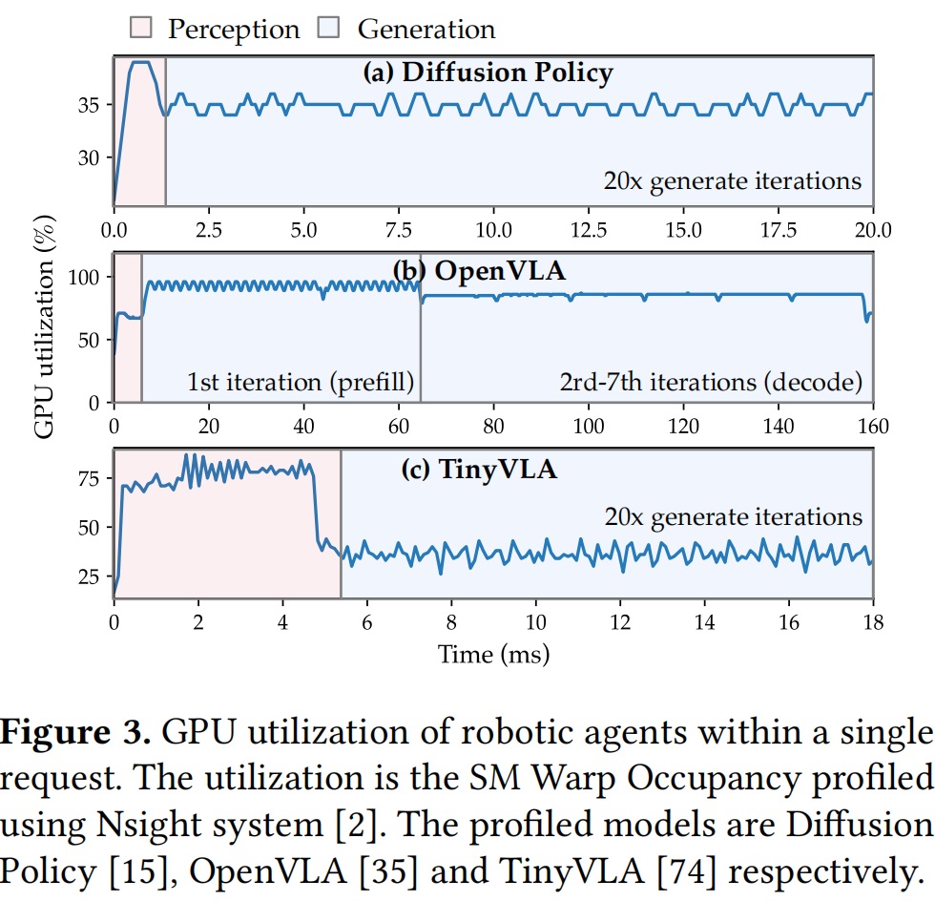
Auras

Slide 5
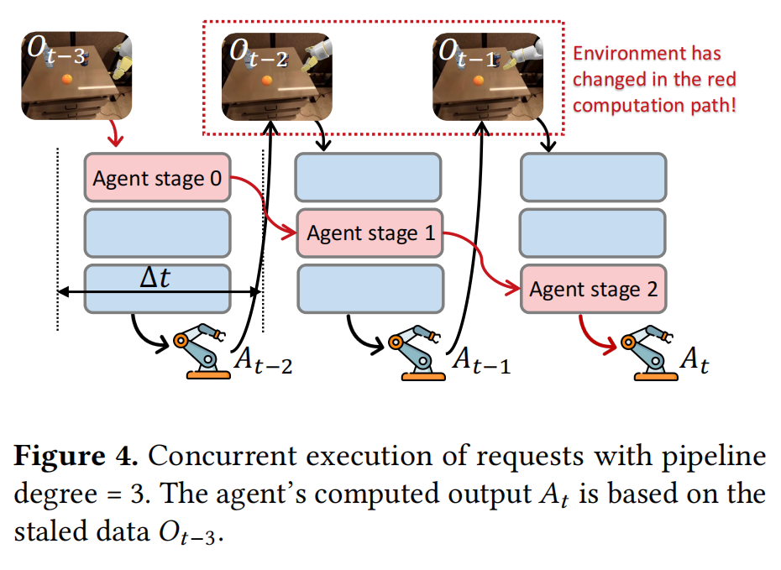
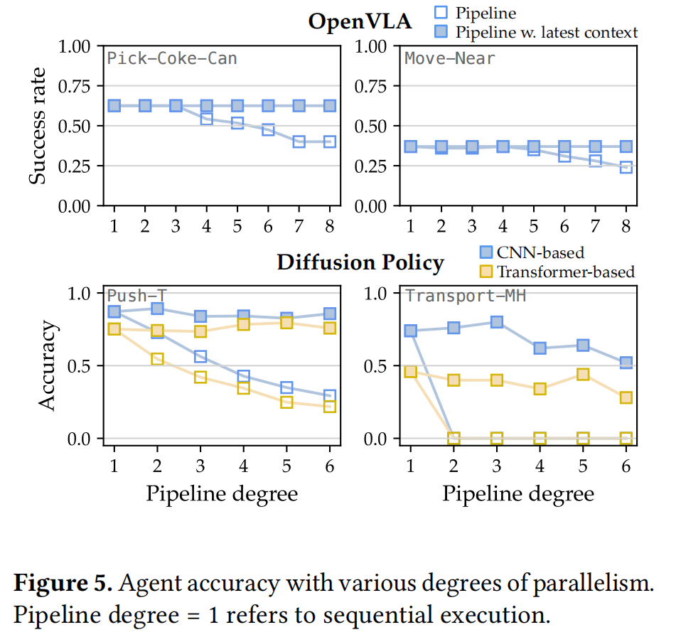
Auras

Slide 6
Auras

